Slide 1
Graphs
DSA

Slide 2
Intro
Our initial part of the course focused on linear data structures—the array, the List, the Queue, the Stack
Then we saw the concept of trees.
trees consist of a set of nodes, where all of the nodes share some connection to other nodes.
These connections are referred to as edges.
For example, all nodes in a tree except for one—the root—must have precisely one parent node, while all nodes can have an arbitrary number of children. These simple rules ensure that, for any tree, the following statements will hold:
Starting from any node, any other node in the tree can be reached. That is, there exists no node that can't be reached through some simple path.
There are no cycles. A cycle exists when, starting from some node v, there is some path that travels through some set of nodes v1, v2, ..., vk that then arrives back at v.
Binary trees are trees whose nodes have at most two children

Slide 3
Intro
Now we're going to examine graphs. Graphs are composed of a set of nodes and edges, just like trees, but with graphs there are no rules for the connections between nodes.
With graphs there is no concept of a root node, nor is there a concept of parents and children. Rather, a graph is just a collection of interconnected nodes.
Realize that all trees are graphs. A tree is a special case of a graph, one whose nodes are all reachable from some starting node and one that has no cycles

Slide 4
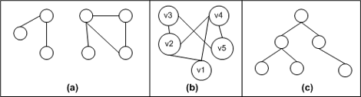
Some examples
Notice that graphs, unlike trees, can have sets of nodes that are disconnected from other sets of nodes.
For example, graph (a) has two distinct, unconnected set of nodes.
Graphs can also contain cycles. Graph (b) has several cycles. One such is the path from v1 to v2 to v4 and back to v1. Another one is from v1 to v2 to v3 to v5 to v4 and back to v1. (There are also cycles in graph (a).)
Graph (c) does not have any cycles, as one less edge than it does number of nodes, and all nodes are reachable. Therefore, it is a tree.

Slide 5
Graphs
a graph is an abstract representation of a set of objects where some pairs of the objects are connected by links.
edges
9
0
4
7
0
vertices

Slide 6
Some applications
Many real-world problems can be modeled using graphs.
For example, search engines model the Internet as a graph, where Web pages are the nodes in the graph and the links among Web pages are the edges.
driving directions from one city to another use graphs, modeling cities as nodes in a graph and the roads connecting the cities as edges.

Slide 7
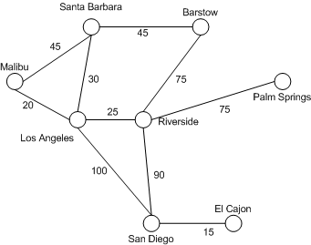
Example
shows a graph that represents cities in California.
The cost of any particular path from one city to another is the sum of the costs of the edges along the path.
The shortest path, then, would be the path with the least cost.
for example, a trip from San Diego to Santa Barbara is 210 miles if driving through Riverside, then to Barstow, and then back to Santa Barbara. The shortest trip, however, is to drive 100 miles to Los Angeles, and then another 30 up to Santa Barabara

Slide 8
A “Real-life” Example of a Graph
V = set of 6 people: John, Mary, Joe, Helen, Tom, and Paul, of ages 12, 15, 12, 15, 13, and 13, respectively
E ={(x,y) | if x is younger than y}
Mary
Helen
John
Joe
Tom
Paul

Slide 9
Examples of Graphs
V={0,1,2,3,4}
E={(0,1), (1,2), (0,3), (3,0), (2,2), (4,3)}
1
When (x,y) is an edge,
we say that x is adjacent to y, and y is adjacent from x.
0 is adjacent to 1.
1 is not adjacent to 0.
2 is adjacent from 1.
0
2
4
3

Slide 10
Intuition Behind Graphs
The nodes represent entities (such as people, cities, computers, words, etc.)
Edges (x,y) represent relationships between entities x and y, such as:
“x likes y”
“x hates y”
“x is a friend of y” (note that this not necessarily reciprocal)
“x considers y a friend”
“x is a child of y”
“x is a half-sibling of y”
“x is a full-sibling of y”
In those examples, each relationship is a different graph

Slide 11
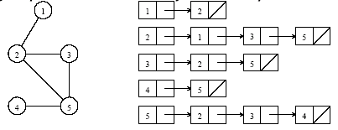
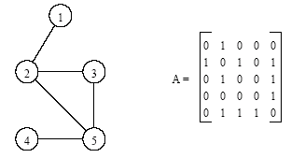
Definitions and Representation
graphs are typically modeled in many ways - two are shown:
As an adjacency list
As an adjacency matrix
An undirected graph and its adjacency list representation
An undirected graph and its adjacency matrix representation.

Slide 12
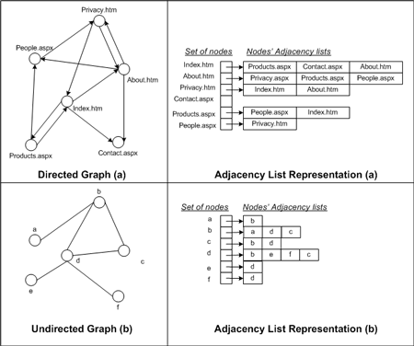
Example - List

Slide 13
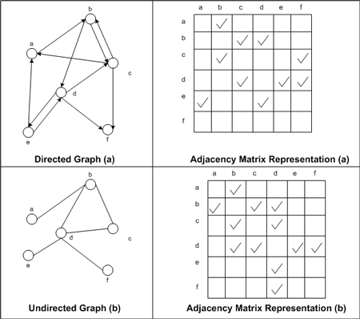
Matrix

Slide 14
Def
A graph is a finite set of nodes with edges between nodes
Formally, a graph G is a structure (V,E) consisting of
a finite set V called the set of nodes, and
a set E that is a subset of VxV. That is, E is a set of pairs of the form (x,y) where x and y are nodes in V

Slide 15
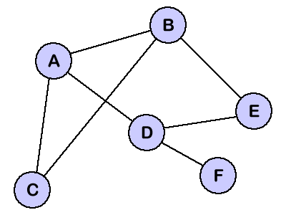
 | A | B | C | D | E | F
A | - | 1 | 1 | 1 | - | -
B | 1 | - | 1 | - | 1 | -
C | 1 | 1 | - | - | - | -
D | 1 | - | - | - | 1 | 1
E | - | 1 | - | 1 | - | -
F | - | - | - | 1 | - | -
Notice that the matrix shown has six rows and six columns labeled with the nodes from the graph.
mark a '1' in a cell if there exists an edge from two nodes that index that cell.
For example, since we have a edge between A and B, we mark a '1' in the cells indexed by A and B.

Slide 16
Weighted Edges
Very often the edges of a graph have weights associated with them.
distance from one vertex to another
cost of going from one vertex to an adjacent vertex.
To represent weight, we need additional field, weight, in each entry.
A graph with weighted edges is called a network.

Slide 17
Types
Directed graphs: G=(V,E) where E is composed of ordered pairs of vertices; i.e. the edges have direction and point from one vertex to another.
Undirected graphs: G=(V,E) where E is composed of unordered pairs of vertices; i.e. the edges are bidirectional.
A graph G is often denoted G=(V,E) where V is the set of vertices and E the set of edges.
Notes:
a complete graph is a simple undirected graph in which every pair of distinct vertices is connected by a unique edge. A complete digraph is a directed graph in which every pair of distinct vertices is connected by a pair of unique edges (one in each direction).

Slide 18
Directed Graph

Slide 19
Undirected Graph

Slide 20
Graph Terminology
The degree of a vertex in an undirected graph is the number of edges that leave/enter the vertex.
The degree of a vertex in a directed graph is the same, but we distinguish between in-degree and out-degree. Degree = in-degree + out-degree.
The running time of a graph algorithm expressed in terms of E and V, where E = |E| and V=|V|; e.g. G=O(EV) is |E| * |V|

Slide 21
Graph Operations
A general operation on a graph G is to visit all vertices in G that are reachable from a vertex v.
Depth-first search
Breath-first search

Slide 22
Operations (ADT)
The basic operations provided by a graph data structure G usually include:
adjacent(G, x, y):
tests whether there is an edge from node x to node y.
neighbors(G, x):
lists all nodes y such that there is an edge from x to y.
add(G, x, y):
adds to G the edge from x to y, if it is not there.
delete(G, x, y):
removes the edge from x to y, if it is there.
get_node_value(G, x):
returns the value associated with the node x.
set_node_value(G, x, a):
sets the value associated with the node x to a.

Slide 23
Example Implementation
typedef struct CELL LIST;
struct CELL {
int nodeKey;
int distance;
struct CELL *next;
};
struct {
char city[50];
struct CELL *adjList;
} cities[100];
2 elements – a vertex and a node.
For vertices, we need to store the element at that vertex.
For an edge, we just need to store a reference to the vertex it is connected to.
Thus, vertex nodes and edge nodes are different things.

Slide 24
example
Index |  | 0 | 1 | 2 | 3 | 4
0 |  | 100 | 60
1 |  | 100
2 |  | 160
3 |  |  | 260
4 |  |  | 260
Chennai
100
60
DEL
100
g1.c
HYD
160
BOM
260
VIZ
260

Slide 25
Summary - Graph
A graph G = (V,E) is composed of:
V: set of vertices
E: set of edges connecting the vertices in V
An edge e = (u,v) is a pair of vertices
Example:
a
b
V= {a,b,c,d,e}
E= {(a,b),(a,c),(a,d),
(b,e),(c,d),(c,e),
(d,e)}
c
d
e

Slide 26
Summary - Some Applications
electronic circuits
networks (roads, flights, communications)
CS16
JFK
LAX
LAX
STL
HNL
DFW
FTL

Slide 27
Terminology: Degree of a Vertex
The degree of a vertex is the number of edges incident to that vertex
For directed graph,
the in-degree of a vertex v is the number of edges that have v as the head
the out-degree of a vertex v is the number of edges that have v as the tail
if di is the degree of a vertex i in a graph G with n vertices and e edges, the number of edges is
Why? Since adjacent vertices each
count the adjoining edge, it will be
counted twice

Slide 28
Examples
0
3
2
0
1
2
3
3
3
1
2
3
3
4
5
6
G1
1
1
1
3
G2
1
3
0
in:1, out: 1
directed graph
1
in: 1, out: 2
in-degree
out-degree
2
in: 1, out: 0
G3

Slide 29
Terminology: Path
path: sequence of vertices v₁,v₂,. . .v_{k} such that consecutive vertices v_{i} and v_{i+1} are adjacent.
3
2
3
3
3
a
b
a
b
c
c
d
e
d
e
a b e d c
b e d c

Slide 30
More Terminology
simple path: no repeated vertices
cycle: simple path, except that the last vertex is the same as the first vertex
a
b
b e c
c
d
e

Slide 31
Even More Terminology
connected graph: any two vertices are connected by some path
connected
not connected
subgraph: subset of vertices and edges forming a graph
connected component: maximal connected subgraph. E.g., the graph below has 3 connected components.

Slide 32
More…
tree - connected graph without cycles
forest - collection of trees

Slide 33
Graph Representations
Adjacency Matrix
Adjacency Lists

Slide 34
Adjacency Matrix
Let G=(V,E) be a graph with n vertices.
The adjacency matrix of G is a two-dimensional n by n array, say adj_mat
If the edge (vi, vj) is in E(G), adj_mat[i][j]=1
If there is no such edge in E(G), adj_mat[i][j]=0
The adjacency matrix for an undirected graph is symmetric; the adjacency matrix for a digraph need not be symmetric

Slide 35
Examples for Adjacency Matrix
0
0
4
0
2
1
5
1
2
3
6
3
1
7
2
G2
G1
symmetric
undirected: n²/2
directed: n²
G4

Slide 36
Spanning Tree

Slide 37
What is A Spanning Tree?
A spanning tree for an undirected graph G=(V,E) is a subgraph of G that is a tree and contains all the vertices of G
Can a graph have more than one spanning tree?
Can an unconnected graph have a spanning tree?
a
b
u
e
c
v
f
d

Slide 38
Minimal Cost Spanning Tree
The cost of a spanning tree of a weighted, undirected graph is the sum of the costs (weights) of the edges in the spanning tree.
A minimum-cost spanning tree is a spanning tree of least cost.
Three greedy-method algorithms available to obtain a minimum-cost spanning tree of a connected, undirected graph.
Kruskal’s algorithm
Prim’s algorithm
Sollin’s algorithm

Slide 39
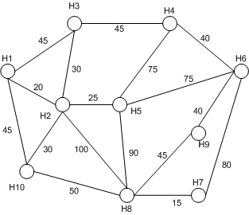
Spanning - Example
Each node is a house, and the edges are the means by which one house can be wired up to another.
The weights of the edges dictate the distance between the homes.
Objective is to wire up all ten houses using the least amount of telephone wiring possible.

Slide 40
Example
A telecommunications company laying cable in a new neighborhood
If it is constrained to bury the cable only along certain paths, then there would be a graph representing which points are connected by those paths.
Some of those paths might be more expensive, because they are longer, or require the cable to be buried deeper; these paths would be represented by edges with larger weights.
A spanning tree for that graph would be a subset of those paths that has no cycles but still connects to every house. There might be several spanning trees possible. A minimum spanning tree would be one with the lowest total cost.

Slide 41
Spanning - Example
Several pins of an electronic circuit must be connected using the least amount of wire.
Modeling the Problem
The graph is a complete, undirected graph G = ( V, E ,W ), where V is the set of pins, E is the set of all possible interconnections between the pairs of pins and w(e) is the length of the wire needed to connect the pair of vertices.
Find a minimum spanning tree.

Slide 42
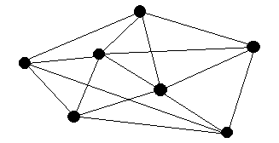
Some definitions
A spanning tree of a graph G is a subgraph of G that is a tree containing all the
vertices of G.
In a weighted graph, a minimum spanning tree is a spanning tree whose sum of
edge weights is as small as possible. It is the most economical tree of a graph with weighted edges.
3
3
3
3
1
2
1
2
1
4
1
4
1
1
2
2
1
5
2
1
5
2
2
1
2
1
4
4

Slide 43
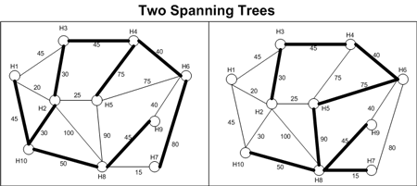
Spanning
For a connected, undirected graph, there exists some subset of the edges that connect all the nodes and does not introduce a cycle.
Such a subset of edges would form a tree (because it would comprise one less edge than vertices and is acyclic), called a spanning tree.
There are typically many spanning trees for a given graph.

Slide 44
Approach
There are two basic approaches to solving the minimum spanning tree problem.

Slide 45
Edges with Min Weight
One approach is build up a spanning tree by choosing the edges with the minimum weight, so long as adding that edge does not create a cycle among the edges chosen thus far

Slide 46
The other approach builds up the spanning tree by dividing the nodes of the graph into two disjoint sets: the nodes currently in the spanning tree and those nodes not yet added. At each iteration, the least weighted edge that connects the spanning tree nodes to a node not in the spanning tree is added to the spanning tree. To start off the algorithm, some random start node must be selected.

Slide 47
Kruskals

Slide 48
Kruskal‘s Algorithm
Each vertex is in its own cluster
2. Take the edge e with the smallest weight
- if e connects two vertices in different clusters,
then e is added to the MST and the two clusters,
which are connected by e, are merged into a single cluster
- if e connects two vertices, which are already in the same
cluster, ignore it
3. Continue until n-1 edges were selected

Slide 49
Each vertex is in its own cluster
2. Take the edge e with the smallest weight
- if e connects two vertices in different clusters,
then e is added to the MST and the two clusters,
which are connected by e, are merged into a single cluster
- if e connects two vertices, which are already in the same
cluster, ignore it
3. Continue until n-1 edges were selected
5
A
B
4
6
2
C
2
D
3
3
1
2
E
F
4

Slide 50
Each vertex is in its own cluster
2. Take the edge e with the smallest weight
- if e connects two vertices in different clusters,
then e is added to the MST and the two clusters,
which are connected by e, are merged into a single cluster
- if e connects two vertices, which are already in the same
cluster, ignore it
3. Continue until n-1 edges were selected
5
A
B
4
6
2
C
2
D
3
3
1
2
E
F
4

Slide 51
Each vertex is in its own cluster
2. Take the edge e with the smallest weight
- if e connects two vertices in different clusters,
then e is added to the MST and the two clusters,
which are connected by e, are merged into a single cluster
- if e connects two vertices, which are already in the same
cluster, ignore it
3. Continue until n-1 edges were selected
5
A
B
4
6
2
C
2
D
3
3
1
2
E
F
4

Slide 52
Each vertex is in its own cluster
2. Take the edge e with the smallest weight
- if e connects two vertices in different clusters,
then e is added to the MST and the two clusters,
which are connected by e, are merged into a single cluster
- if e connects two vertices, which are already in the same
cluster, ignore it
3. Continue until n-1 edges were selected
5
A
B
4
6
2
C
2
D
3
3
1
2
E
F
4

Slide 53
Each vertex is in its own cluster
2. Take the edge e with the smallest weight
- if e connects two vertices in different clusters,
then e is added to the MST and the two clusters,
which are connected by e, are merged into a single cluster
- if e connects two vertices, which are already in the same
cluster, ignore it
3. Continue until n-1 edges were selected
5
A
B
4
6
2
C
2
D
3
3
1
2
E
F
4

Slide 54
Each vertex is in its own cluster
2. Take the edge e with the smallest weight
- if e connects two vertices in different clusters,
then e is added to the MST and the two clusters,
which are connected by e, are merged into a single cluster
- if e connects two vertices, which are already in the same
cluster, ignore it
3. Continue until n-1 edges were selected
5
A
B
4
6
2
C
2
D
3
cycle!!
3
1
2
E
F
4

Slide 55
Each vertex is in its own cluster
2. Take the edge e with the smallest weight
- if e connects two vertices in different clusters,
then e is added to the MST and the two clusters,
which are connected by e, are merged into a single cluster
- if e connects two vertices, which are already in the same
cluster, ignore it
3. Continue until n-1 edges were selected
5
A
B
4
6
2
C
2
D
3
3
1
2
E
F
4

Slide 56
Each vertex is in its own cluster
2. Take the edge e with the smallest weight
- if e connects two vertices in different clusters,
then e is added to the MST and the two clusters,
which are connected by e, are merged into a single cluster
- if e connects two vertices, which are already in the same
cluster, ignore it
3. Continue until n-1 edges were selected
5
A
B
4
6
2
C
2
D
3
3
1
2
E
F
4

Slide 57
minimum- spanning tree
A
B
2
C
2
D
3
1
2
E
F

Slide 58
The correctness of Kruskal‘s Algorithm
Crucial Fact about MSTs
Running time: O ( m log n )
By implementing queue Q as a heap, Q could be initialized in O ( m ) time and a vertex could be extracted in each iteration in O ( log n ) time

Slide 59
Code Fragment
Input: A weighted connected graph G with n vertices and m edges
Output: A minimum-spanning tree T for G
for each vertex v in G do
Define a cluster C(v) = {v}.
Initialize a priority queue Q to contain all edges in G, using weights as keys.
T = NULL
while Q != NULL do
Extract (and remove) from Q an edge (v,u) with smallest weight.
Let C(v) be the cluster containing v, and let C(u) be the cluster containing u.
if C(v) != C(u) then
Add edge (v,u) to T.
Merge C(v) and C(u) into one cluster, that is, union C(v) and C(u).
return tree T

Slide 60
Kruskals
Starts with a “FOREST” which consists of “TREES”
Each TREE is only one node
In Every step, two different trees are connected to a bigger tree
Until we end up in a tree which is the minimum genetic tree

Slide 61
Prim‘s Algorithm
All vertices are marked as not visited
2. Any vertex v you like is chosen as starting vertex and
is marked as visited (define a cluster C)
The smallest- weighted edge e = (v,u), which connects
one vertex v inside the cluster C with another vertex u outside
of C, is chosen and is added to the MST.
4. The process is repeated until a spanning tree is formed

Slide 62
Prim’s Algo
Determines a minimal spanning tree in a connected graph

Slide 63
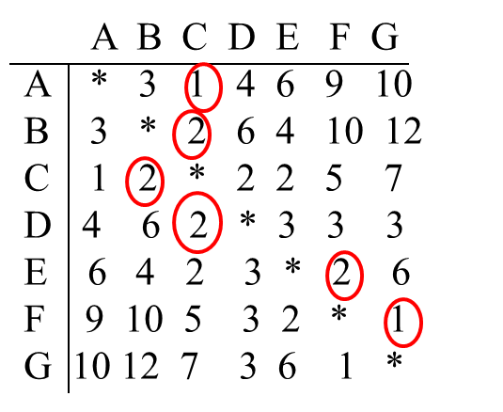

Prim’s
Prim’s algorithm states: Setting n= to the number of vertices, repeat the following step until the tree T has n-1 edges: Add to T the shortest edge between a vertex in T and a vertex not in T (initially pick any edge of the shortest length).
Here n = 7; T will have 6 edges
10
G
D
A
4
3
9
7
1
6
2
3
1
3
3
6
C
5
2
6
2
F
B
2
4
E
12
10

Slide 64
5
A
B
4
6
2
C
2
D
3
3
1
2
E
F
4

Slide 65
5
A
B
4
6
2
C
2
D
3
3
1
2
E
F
4

Slide 66
We could delete these edges because of Dijkstra‘s label D[u] for each vertex outside of the cluster
5
A
B
4
6
2
C
2
D
3
3
1
2
E
F
4

Slide 67
A
B
2
C
2
D
3
3
1
2
E
F
4

Slide 68
A
B
2
C
2
D
3
3
1
2
E
F

Slide 69
A
B
2
C
2
D
3
3
1
2
E
F

Slide 70
A
B
2
C
2
D
3
1
2
E
F

Slide 71
A
B
2
C
2
D
3
1
2
E
F

Slide 72
minimum- spanning tree
A
B
2
C
2
D
3
1
2
E
F

Slide 73
The correctness of Prim‘s Algorithm
Crucial Fact about MSTs
Running time: O ( m log n )
By implementing queue Q as a heap, Q could be initialized in O ( m ) time and a vertex could be extracted in each iteration in O ( log n ) time

Slide 74
Another example - Prim’s
Approach:
Choose an arbitrary start node v
At any point in time, we have connected component N containing v and other nodes V-N
Choose the minimum weight edge from N to V-N
Algorithm:
let T be a single vertex x
while (T has fewer than n vertices)
{
find the smallest edge connecting T to G-T
add it to T
}

Slide 75
Choose any vertex to start
Look at all Edges connecting to the vertex
Choose one with the lowest weight and add to this tree
Look at all edges connected to the tree
Choose one with the lowest weight and add to this tree
Repeat until all vertices are covered

Slide 76
Prim's Algorithm - Example
8
12
13
9
2
11
20
40
14
7
50
6
10
1
3

Slide 77
Prim's Algorithm - Example
8
12
13
9
2
11
20
40
14
7
50
6
10
1
3

Slide 78
Prim's Algorithm - Example
8
12
13
9
2
11
20
40
14
7
50
6
10
1
3

Slide 79
Prim's Algorithm - Example
8
12
13
9
2
11
20
40
14
7
50
6
10
1
3

Slide 80
Prim's Algorithm - Example
8
12
13
9
2
11
20
40
14
7
50
6
10
1
3

Slide 81
Prim's Algorithm - Example
8
12
13
9
2
11
20
40
14
7
50
6
10
1
3

Slide 82
Prim's Algorithm - Example
8
12
13
9
2
11
20
40
14
7
50
6
10
1
3

Slide 83
Prim's Algorithm - Example
8
12
13
9
2
11
20
40
14
7
50
6
10
1
3

Slide 84
Prim's Algorithm - Example
8
12
13
9
2
11
20
40
14
7
50
6
10
1
3

Slide 85
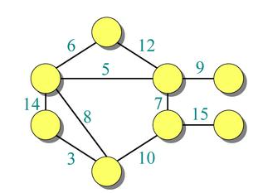

Slide 86
Topological Sort

Slide 87
Topological Sort
a topological sort (ordering) is a linear ordering of its vertices such that, for every edge uv, u comes before v in the ordering
Consider a Project Management chart in the form of a graph, the vertices of the graph may represent tasks to be performed, and the edges may represent constraints that one task must be performed before another; in this application, a topological ordering is just a valid sequence for the tasks
A topological ordering is possible if and only if the graph has no directed cycles, that is, if it is a directed acyclic graph (DAG). Any DAG has at least one topological ordering, and algorithms are known for constructing a topological ordering of any DAG in linear time.

Slide 88
Graph Algorithms: Topological Sort
The topological sorting problem: given a directed,
acyclic graph G = (V, E) , find a linear ordering of
the vertices such that
for all (v, w)  E, v precedes w in the ordering.
B
C
A
F
D
E

Slide 89
Graph Algorithms: Topological Sort
The topological sorting problem: given a directed,
acyclic graph G = (V, E) , find a linear ordering of
the vertices such that
for all (v, w)  E, v precedes w in the ordering.
B
C
A
F
A
B
F
C
D
E
D
E

Slide 90
Graph Algorithms: Topological Sort
The topological sorting problem: given a directed,
acyclic graph G = (V, E) , find a linear ordering of
the vertices such that
for all (v, w)  E, v precedes w in the ordering.
Any linear ordering in which
all the arrows go to the right.
B
C
A
F
A
B
F
C
D
E
D
E

Slide 91
Graph Algorithms: Topological Sort
The topological sorting problem: given a directed,
acyclic graph G = (V, E) , find a linear ordering of
the vertices such that
for all (v, w)  E, v precedes w in the ordering.
Any linear ordering in which
all the arrows go to the right.
B
C
A
F
A
B
E
C
D
F
D
E
This is not a topological
ordering.

Slide 92
Graph Algorithms: Topological Sort
The topological sorting algorithm:
Identify the subset of vertices that have no
incoming edge.
B
C
A
F
D
E

Slide 93
Graph Algorithms: Topological Sort
The topological sorting algorithm:
Identify the subset of vertices that have no
incoming edge. (In general, this subset must
be nonempty—why?)
B
C
A
F
D
E

Slide 94
Graph Algorithms: Topological Sort
The topological sorting algorithm:
Identify the subset of vertices that have no
incoming edge. (In general, this subset must
be nonempty—because the graph is acyclic.)
B
C
A
F
D
E

Slide 95
Graph Algorithms: Topological Sort
The topological sorting algorithm:
Identify the subset of vertices that have no
incoming edge. Select one of them.
B
C
A
F
D
E

Slide 96
Graph Algorithms: Topological Sort
The topological sorting algorithm:
Remove it, and its outgoing edges,
and add it to the output.
B
C
F
A
D
E

Slide 97
Graph Algorithms: Topological Sort
The topological sorting algorithm:
Again, identify the subset of vertices that have no
incoming edge, . . .
B
C
F
A
D
E

Slide 98
Graph Algorithms: Topological Sort
The topological sorting algorithm:
Again, identify the subset of vertices that have no
incoming edge, select one of them, . . .
B
C
F
A
D
E

Slide 99
Graph Algorithms: Topological Sort
The topological sorting algorithm:
Again, identify the subset of vertices that have no
incoming edge, select one of them, remove
it and any outgoing edges, and put it in the output.
B
C
A
F
D
E

Slide 100
Graph Algorithms: Topological Sort
The topological sorting algorithm:
Again, identify the subset of vertices that have no
incoming edge, select one of them, remove
it and any outgoing edges, and put it in the output.
B
C
A
F
D
E

Slide 101
Graph Algorithms: Topological Sort
The topological sorting algorithm:
Again, identify the subset of vertices that have no
incoming edge, select one of them, remove
it and any outgoing edges, and put it in the output.
C
A
F
B
D
E

Slide 102
Graph Algorithms: Topological Sort
The topological sorting algorithm:
Again, identify the subset of vertices that have no
incoming edge, select one of them, remove
it and any outgoing edges, and put it in the output.
C
A
F
B
D
E

Slide 103
Graph Algorithms: Topological Sort
The topological sorting algorithm:
Again, identify the subset of vertices that have no
incoming edge, select one of them, remove
it and any outgoing edges, and put it in the output.
A
F
B
C
D
E

Slide 104
Graph Algorithms: Topological Sort
The topological sorting algorithm:
Again, identify the subset of vertices that have no
incoming edge, select one of them, remove
it and any outgoing edges, and put it in the output.
A
F
B
C
D
E

Slide 105
Graph Algorithms: Topological Sort
The topological sorting algorithm:
Again, identify the subset of vertices that have no
incoming edge, select one of them, remove
it and any outgoing edges, and put it in the output.
A
F
B
C
D
E

Slide 106
Graph Algorithms: Topological Sort
The topological sorting algorithm:
Again, identify the subset of vertices that have no
incoming edge, select one of them, remove
it and any outgoing edges, and put it in the output.
A
F
B
C
D
E

Slide 107
Graph Algorithms: Topological Sort
The topological sorting algorithm:
Again, identify the subset of vertices that have no
incoming edge, select one of them, remove
it and any outgoing edges, and put it in the output.
A
F
B
C
D
E

Slide 108
Graph Algorithms: Topological Sort
The topological sorting algorithm:
finished!
B
C
A
F
A
F
B
C
D
E
D
E

Slide 109
Graph Algorithms: Topological Sort
The topological sorting algorithm:
Time bound?
B
C
A
F
A
F
B
C
D
E
D
E

Slide 110
Graph Algorithms: Topological Sort
The topological sorting algorithm:
Time bound: Break down into total time to:
Find vertices with no predecessors: ?
Remove edges: ?
Place vertices in output: ?
B
C
A
F
A
F
B
C
D
E
D
E

Slide 111
Graph Algorithms: Topological Sort
The topological sorting algorithm:
Time bound: Break down into total time to:
Find vertices with no predecessors: ?
Remove edges: O(|E|)
Place vertices in output: ?
B
C
A
F
A
F
B
C
D
E
D
E

Slide 112
Graph Algorithms: Topological Sort
The topological sorting algorithm:
Time bound: Break down into total time to:
Find vertices with no predecessors: ?
Remove edges: O(|E|)
Place vertices in output: O(|V|)
B
C
A
F
A
F
B
C
D
E
D
E

Slide 113
Graph Algorithms: Topological Sort
Find vertices with no predecessors: ?
Assume an adjacency list representation:
A
B
C
D
E
F
B
D
B
C
C
A
D
E
F
E
D
E

Slide 114
Graph Algorithms: Topological Sort
The topological sorting algorithm:
…and initialize and maintain for each vertex
its no. of predecessors.
A
B
C
D
E
F
0
B
D
1
1
B
1
C
0
C
A
0
1
D
E
F
2
E
2
2
D
2
E
0

Slide 115
Graph Algorithms: Topological Sort
Find vertices with no predecessors: ?
Time for each vertex: O(|V|)
A
B
C
D
E
F
0
B
D
B
1
C
C
A
1
D
E
F
2
E
D
2
E
0

Slide 116
Graph Algorithms: Topological Sort
Find vertices with no predecessors: ?
2
Total time: O(|V| )
A
B
C
D
E
F
0
B
D
B
1
C
C
A
1
D
E
F
2
E
D
2
E
0

Slide 117
Graph Algorithms: Topological Sort
The topological sorting algorithm:
Time bound: Break down into total time to:
Find vertices with no predecessors: O(|V| )
Remove edges: O(|E|)
Place vertices in output: O(|V|)
2

Slide 118
Graph Algorithms: Topological Sort
The topological sorting algorithm:
Time bound: Break down into total time to:
Find vertices with no predecessors: O(|V| )
Remove edges: O(|E|)
Place vertices in output: O(|V|)
2
2
Total: O(|V| + |E|)

Slide 119
Graph Algorithms: Topological Sort
The topological sorting algorithm:
Time bound: Break down into total time to:
Find vertices with no predecessors: O(|V| )
Remove edges: O(|E|)
Place vertices in output: O(|V|)
2
2
Total: O(|V| + |E|)
Too much!

Slide 120
Graph Algorithms: Topological Sort
The topological sorting algorithm:
We need a faster way to do this step:
Find vertices with no predecessors.

Slide 121
Graph Algorithms: Topological Sort
The topological sorting algorithm:
Key idea: initialize and maintain a queue (or stack)
holding pointers to the vertices with 0 predecessors
A
B
C
D
E
F
0
B
D
1
1
B
1
C
0
C
A
0
1
D
E
F
2
E
2
2
D
2
E
0

Slide 122
Graph Algorithms: Topological Sort
The topological sorting algorithm:
As each vertex is removed, update the predecessor counts, and for any vertex whose count has become 0, put it in the queue.
A
B
C
D
E
F
0
B
D
1
1
B
1
C
0
C
A
0
1
D
E
F
2
E
2
2
D
2
E
0

Slide 123
Graph Algorithms: Topological Sort
The topological sorting algorithm:
As each vertex is removed, update the predecessor counts, and for any vertex whose count has become 0, put it in the queue.
No scan is
required, so O(1).
A
B
C
D
E
F
0
0
1
B
0
C
C
0
1
D
E
F
1
E
1
2
D
2
E
Output:
A
0

Slide 124
Graph Algorithms: Topological Sort
The topological sorting algorithm:
As each vertex is removed, update the predecessor counts, and for any vertex whose count has become 0, put it in the queue.
A
B
C
D
E
F
0
0
1
B
0
C
C
1
D
E
1
E
1
2
D
2
E
Output:
A F
0

Slide 125
Graph Algorithms: Topological Sort
The topological sorting algorithm:
As each vertex is removed, update the predecessor counts, and for any vertex whose count has become 0, put it in the queue.
A
B
C
D
E
F
0
0
0
C
0
D
E
1
E
1
2
D
2
E
Output:
A F B
0

Slide 126
Graph Algorithms: Topological Sort
The topological sorting algorithm:
As each vertex is removed, update the predecessor counts, and for any vertex whose count has become 0, put it in the queue.
A
B
C
D
E
F
0
0
0
0
E
0
1
D
1
E
Output:
A F B C
0

Slide 127
Graph Algorithms: Topological Sort
The topological sorting algorithm:
As each vertex is removed, update the predecessor counts, and for any vertex whose count has become 0, put it in the queue.
A
B
C
D
E
F
0
0
0
0
0
0
E
Output:
A F B C D
0

Slide 128
Graph Algorithms: Topological Sort
The topological sorting algorithm:
As each vertex is removed, update the predecessor counts, and for any vertex whose count has become 0, put it in the queue.
Completed!
A
B
C
D
E
F
0
0
0
0
0
Output:
A F B C D E
0

Slide 129
Graph Algorithms: Topological Sort
The topological sorting algorithm:
Time bound: Now the time for each part is
Find vertices with no predecessors: O(|V|)
Remove edges: O(|E|)
Place vertices in output: O(|V|)
Total: O(|V|+|E|)
Linear in |V|+|E|.
Much better!

Slide 130
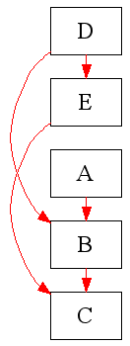
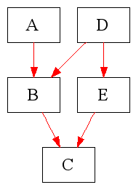
Examples
ADBEC
What about the following
ADEBC?
CBAED?
ABCDE?
DECAB?

Slide 131
One more example - Topological Ordering
v₂
v₃
v₆
v₅
v₄
v₁
v₂
v₃
v₄
v₅
v₆
v₇
v₇
v₁
Topological order: v₁, v₂, v₃, v₄, v₅, v₆, v₇.

Slide 132
Algo
L ← Empty list that will contain the sorted elements
S ← Set of all nodes with no incoming edges
while S is non-empty do
remove a node n from S
insert n into L
for each node m with an edge e from n to m do
remove edge e from the graph
if m has no other incoming edges then
insert m into S
if graph has edges then
return error (graph has at least one cycle)
else
return L (a topologically sorted order)

Slide 133
Algo – depth-first
L ← Empty list that will contain the sorted nodes
S ← Set of all nodes with no outgoing edges
for each node n in S do
visit(n)
function visit(node n)
if n has not been visited yet then
mark n as visited
for each node m with an edge from m to n do
visit(m)
add n to L

